Slide 1
Language, Race, & Identity Unit Cycle 2:
Crown: An Ode to the Fresh Cut

Slide 2
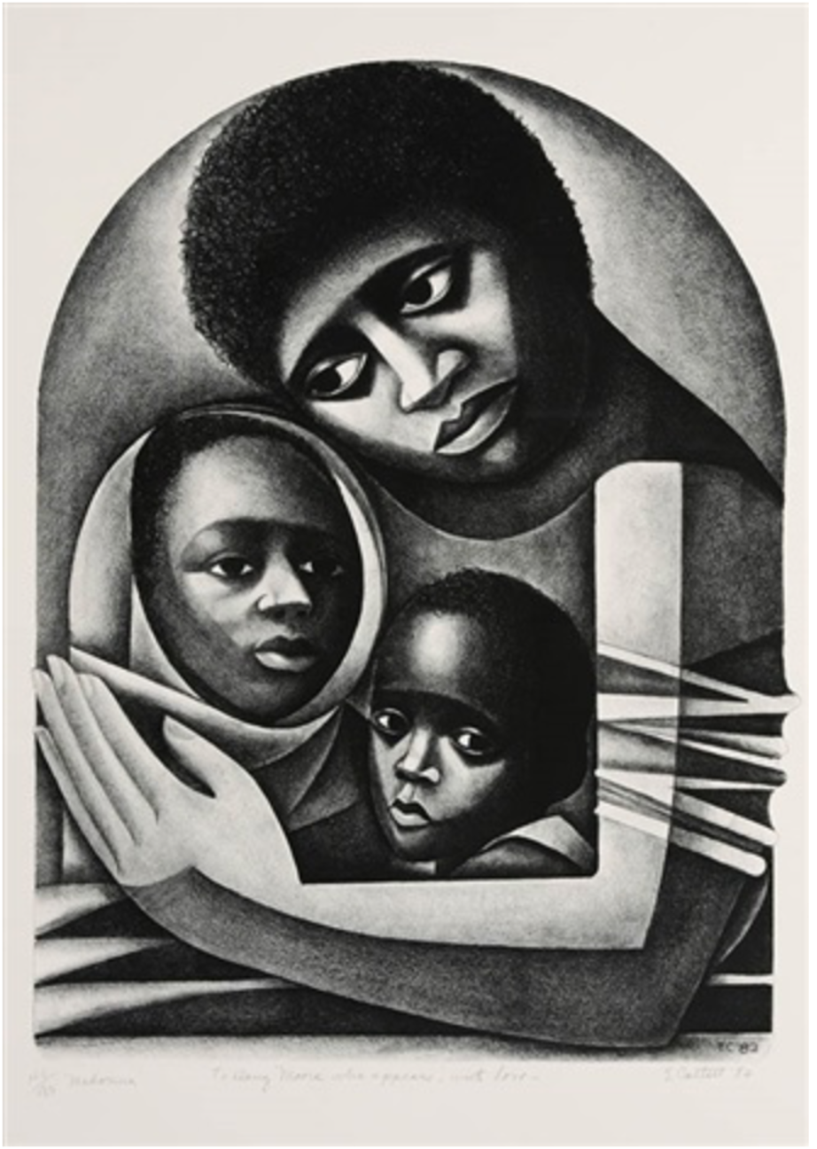
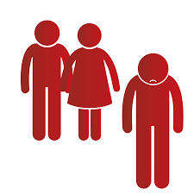
Unit Vocabulary
Flawless
Masterful
Visible
Bias
Discriminate
Policy

Slide 3
Day 1: Words of the Day
Flawless
Masterful
Visible

Slide 4
Flawless
Adjective

Slide 5
Flawless
Have you heard this word before?
What do you know about this word?

Slide 6
Flawless
Flaw = mistake
-less = without
Do you know any other words that end with “-less”? Can you guess their meanings? (e.g. harmless, hopeless)

Slide 7
Flawless means something perfect without any mistakes.
The designer crafted a flawless line with his razor.

Slide 8
The Spanish translation of flawless is:
perfecto/perfecta

Slide 9
The Mandarin translation of flawless is:

Slide 10
The Cantonese translation of flawless is:
完 美 無 瑕
yun4 mei5 mou4 ha4

Slide 11
Masterful
Adjective

Slide 12
Masterful
Have you heard this word before?
What do you know about this word?

Slide 13
Masterful
Mastery = excellence
-ful = full of
Do you know any other words that end with “-ful”? Can you guess their meanings? (e.g. beautiful, handful)

Slide 14
Masterful means someone is showing great skill doing something.
Madonna is a masterful painting by Elizabeth Catlett.

Slide 15
The Spanish translation of masterful is:
maestro/maestra

Slide 16
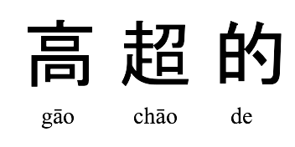
The Mandarin translation of masterful is:

Slide 17
The Cantonese translation of masterful is:
高 超
gou1 ciu1

Slide 18
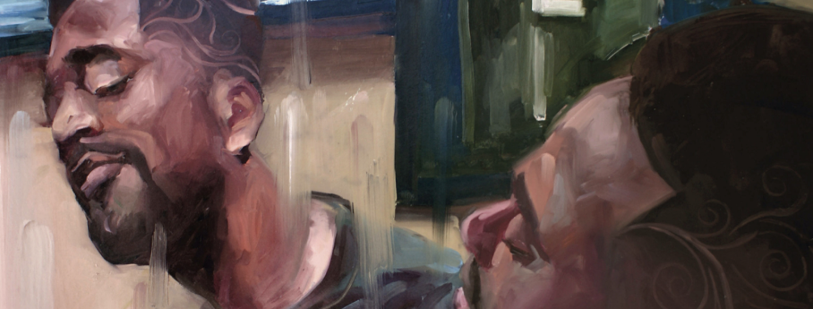
How do you think being flawless is similar to being masterful?
In the picture, the man loves the masterful design crafted on the side of his head.
In the book, the boy had a magnificent and flawless hair cut.

Slide 19
Flawless
Masterful
Do you know how to say these words in any other languages?
Do these words remind you of other related words?

Slide 20
Visible
Adjective

Slide 21
Visible
Have you heard this word before?
What do you know about this word?

Slide 22
Visible
-ible/able = to be able to do something

Slide 23
Visible means something is able to be seen.
The Golden Gate Bridge is visible from miles away.
DO YOU KNOW ANY WORDS RELATED TO VISIBLE?
vision, invisible, vista

Slide 24
The Spanish translation of visible is:
visible

Slide 25
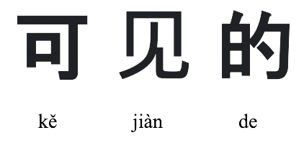
The Mandarin translation of visible is:

Slide 26
The Cantonese translation of visible is:
睇 得 見
tai2 dak1 gin3

Slide 27
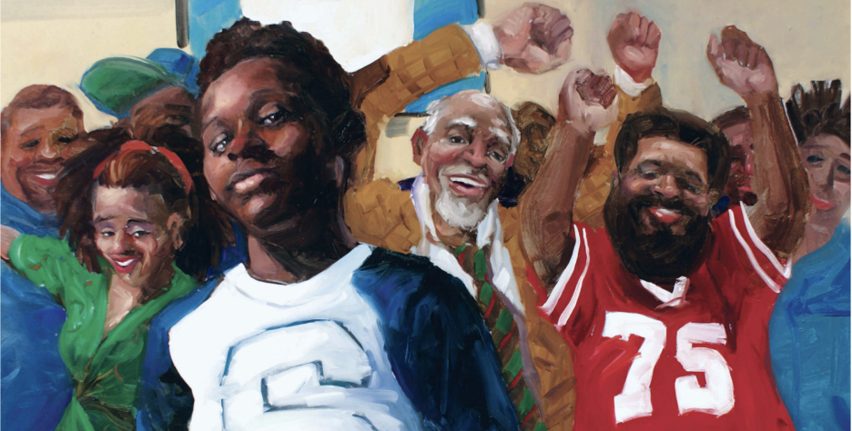
Visible
Many people believe that hair is important visible feature of their identity.
CAN YOU GUESS WHAT IS THE MEANING OF THE WORD PART “-IBLE”?

Slide 28
Visible
Do you know how to say this word in any other languages?
Do you know any synonyms for this word?
Do you know any antonyms for this word?

Slide 29
Day 2: Words of the Day
Bias
Discriminate
Policy

Slide 30
Bias
Noun

Slide 31
Bias
Have you heard this word before?
What do you know about this word?

Slide 32
Bias means favoring certain ideas or people over others in an unjust or unfair way.
A Charter School in Malden Massachusetts had hair rules that were biased. The school banned hair extensions in classrooms. This rule was biased because Black students were more likely to wear extensions than their peers.

Slide 33
The Spanish translation of bias is:
parcialidad

Slide 34
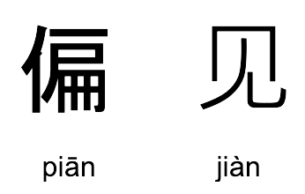
The Mandarin translation of bias is:

Slide 35
The Cantonese translation of bias is:
偏 見
pin1 gin3

Slide 36
Bias
Do you know how to say this word in any other languages?
Do you know any synonyms for this word?
Do you know any antonyms for this word?

Slide 37
Discriminate
Verb

Slide 38
Discriminate
Have you heard this word before?
What do you know about this word?

Slide 39
Discriminate means to treat people unjustly because of who they are or what they believe.
On March 8, 2017, many businesses closed for an event “A Day Without a Woman” to protest discrimination based on gender.

Slide 40
The Spanish translation of discriminate is:
discriminar

Slide 41
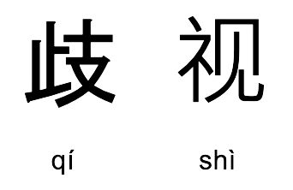
The Mandarin translation of discriminate is:

Slide 42
The Cantonese translation of discriminate is:
歧 視
kei4 si6

Slide 43
Discriminate
Do you know how to say this word in any other languages?
Do you know any synonyms for this word?
Do you know any antonyms for this word?

Slide 44
Policy
Noun

Slide 45
Policy
Have you heard this word before?
What do you know about this word?

Slide 46
A policy is a contract or law made by an institution (like schools or governments).
Wearing school uniforms is a school policy at many schools.
Do you know other policies at your school?

Slide 47
The Spanish translation of policy is:
política

Slide 48
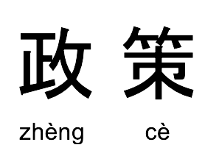
The Mandarin translation of policy is:

Slide 49
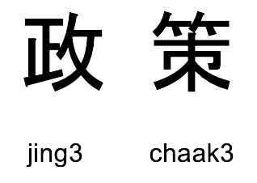
The Cantonese translation of policy is:

Slide 50
Policy
Do you know how to say this word in any other languages?
Do you know any synonyms for this word?
Do you know any antonyms for this word?

Slide 51
Time to Review
Something perfect without any mistakes
Someone is showing great skill doing something
Something is able to be seen
Favoring certain ideas or people over others in an unjust or unfair way
To treat people unjustly because of who they are or what they believe
A contract or law made by an institution (like schools or governments)
Flawless
Masterful
Visible
Bias
Discriminate
Policy

Slide 52
Time to Review
-less
-ble/-able
Without
To be able to do something
-ful
-ate
Full of
To act on

Slide 53
Black Hair
Notes:
Video URL: https://www.youtube.com/watch?v=MwCqKXV8300

Slide 54
Wordwall: Hair and Identity
https://wordwall.net/resource/30567551/v2-hair-and-identity
Notes:
https://wordwall.net/resource/30567551/v2-hair-and-identity

Slide 55
Wordwall: Playing with Syntax
https://wordwall.net/resource/31180660/lesson-4-playing-with-syntax
Notes:
https://wordwall.net/resource/31180660/lesson-4-playing-with-syntax

Slide 56
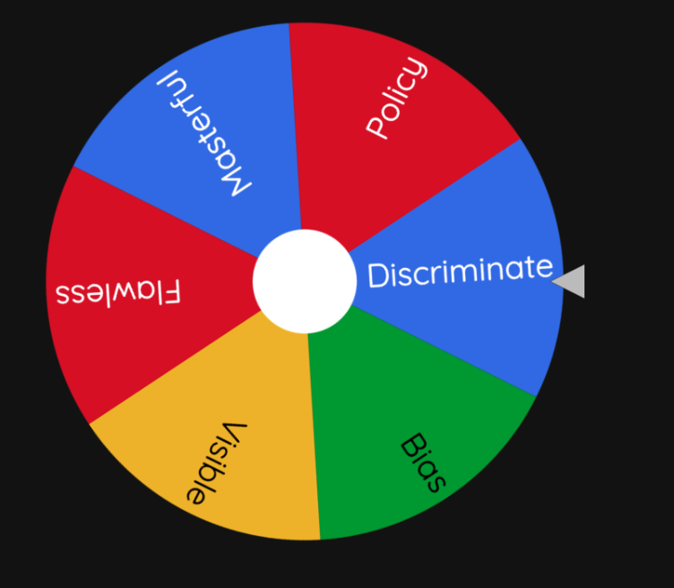
CLAVES Definition Wheel
https://wheelofnames.com/wnx-xjq
Notes:
https://wheelofnames.com/wnx-xjq

Slide 57
Lesson Links
Lesson 2
Black Hair
https://www.youtube.com/watch?v=MwCqKXV8300
Lesson 3
Wordwall: Hair and Identity
https://wordwall.net/resource/30567551/v2-hair-and-identity
Lesson 4
Wordwall: Playing with Syntax
https://wordwall.net/resource/31180660/lesson-4-playing-with-syntax
Lesson 5
CLAVES Definition Wheel
https://wheelofnames.com/wnx-xjq
1
2
3
4

