Slide 1
Introduction to Unit 1: Humans and Nature

Slide 2
Our Big Questions
How are humans and nature interdependent?
How do humans affect nature?

Slide 3
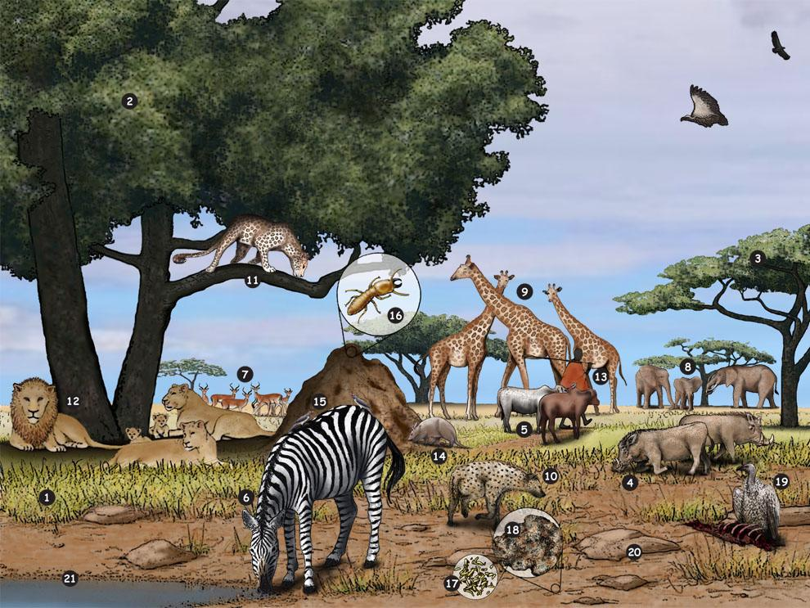
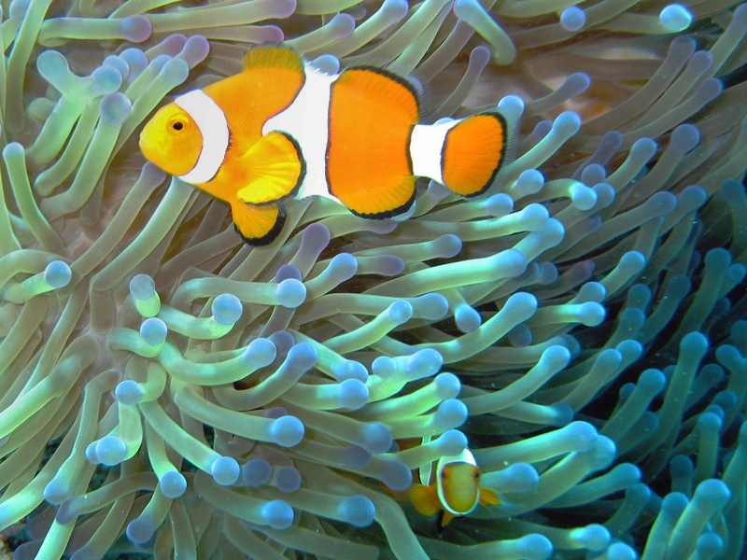
Words of the Day
Ecosystem
Interdependence
Balance

Slide 4
Ecosystem
Noun

Slide 5
Ecosystem
Have you heard this word before?
What do you know about this word?

Slide 6
Ecosystem
Eco = environment
System = a group of things that work together

Slide 7
Ecosystem is the different groups of life found in an environment.
What different kinds of life do you see in this ecosystem?

Slide 8
The Spanish translation of ecosystem is:
ecosistema

Slide 9
Cognates
Two Spanish and English words that look alike and mean the same thing are called cognates.
Ecosystem
Ecosistema

Slide 10
The Mandarin translation of ecosystem is:
生 态 系 统
shēng tài xì tǒng

Slide 11
The Mandarin translation of
eco = environment:
环 境
huán jìng

Slide 12
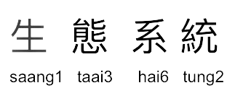
The Cantonese translation of ecosystem is:

Slide 13
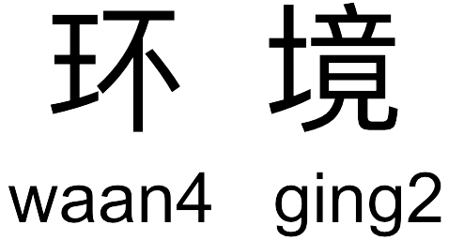
The Cantonese translation of
eco = environment:

Slide 14
Interdependence
Noun

Slide 15
Interdependence
Have you heard this word before?
What do you know about this word?

Slide 16
Interdependence
Inter = among or together
Dependence = needing

Slide 17
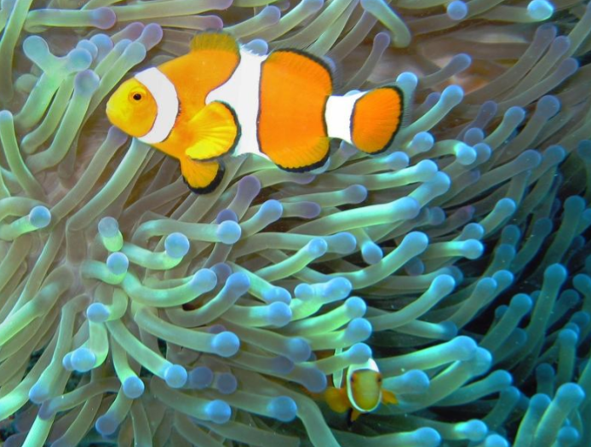
Interdependence means things need each other to survive.
In the picture, the blue sea anemone and the orange and white clownfish are interdependent. The clownfish eats insects and other animals that can hurt the sea anemone and the sea anemone protects the clownfish from being eaten by bigger fish with its swinging arms.

Slide 18
The Spanish translation of interdependence is:
interdependencia

Slide 19
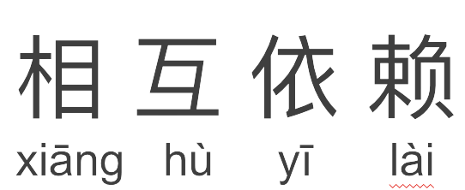
The Mandarin translation of interdependence is:

Slide 20
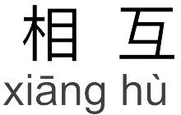
The Mandarin translation of inter = among or together:

Slide 21
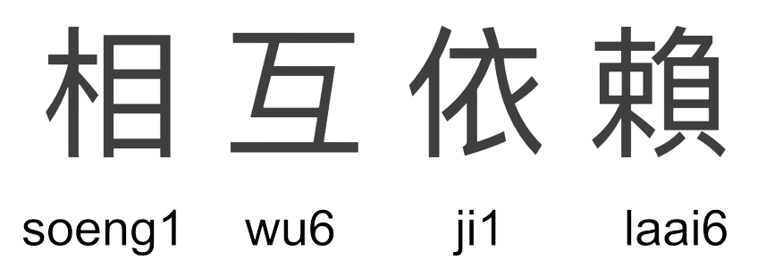
The Cantonese translation of interdependence is:

Slide 22
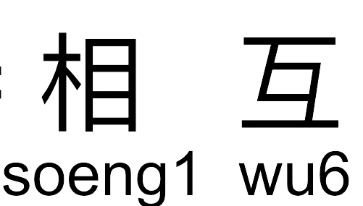
The Cantonese translation of inter = among or together

Slide 23
Balance
Noun

Slide 24
Balance
Have you heard this word before?
What do you know about this word?

Slide 25
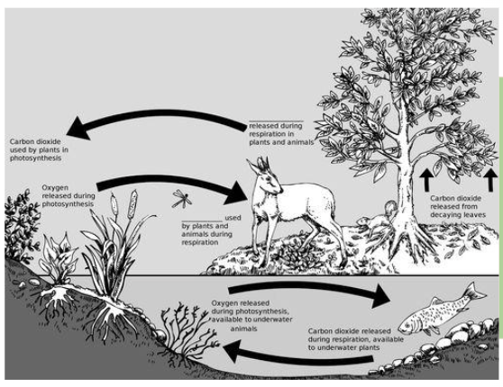
Balance means a steady, stable position or condition.
Ecosystems need to be in balance for everything to survive. This picture shows how the water, tree, deer, fish, plants, and insects in this ecosystem are all interdependent which creates balance.

Slide 26
The Spanish translation of balance is:
equilibrio

Slide 27
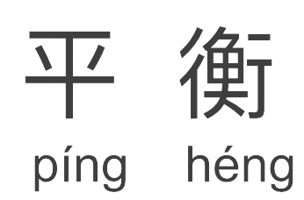
The Mandarin translation of balance is:

Slide 28
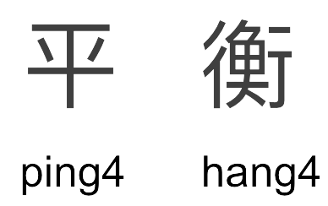
The Cantonese translation of balance is:

Slide 29
Time to Review
Eco-
Environment
The different groups of life found in an environment.
When things need each other to survive
A steady, stable position or condition
Inter-
Among or together
Ecosystem
Interdependence
Balance

Slide 30
Is It Time To Reassess Our Relationship with Nature?
Notes:
https://www.youtube.com/watch?v=r6SOxLO-Pzo

Slide 31
Lesson Links
1
Is It Time To Reassess Our Relationship with Nature?
https://www.youtube.com/watch?v=r6SOxLO-Pzo
2
3
4

